Slide 1


Slide 2

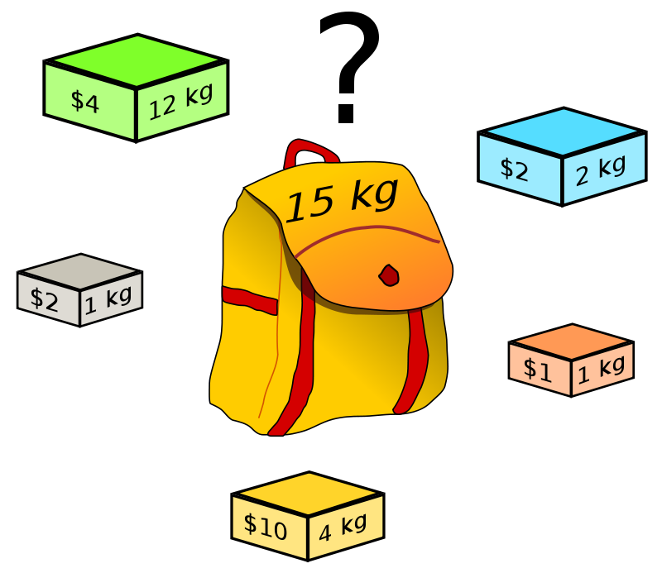

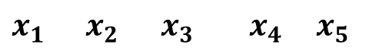
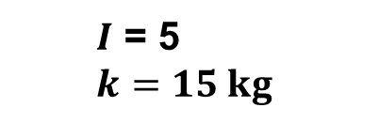
Problema de la mochila
Objetivo
- Maximizar: $\sum_{i ε I}{v_{i}x_{i}}$
- Sujeto a: $\sum_{i ε I}{w_{i}x_{i}≤k}$
$x_{i}∈0,1 (i ∈I)$
Donde:
- $v_{i}$ es el valor de cada objeto.
- $x_{i}$ indica si el objeto es colocado en la mochila.
- $w_{i}$ es el peso de cada objeto.
- $I$ es el número de objetos.
- $k$ es la capacidad de la mochila.
$x_{1}$ $x_{2}$ $x_{3}$ $x_{4}$ $x_{5}$
0 | 1 | 1 | 1 | 1
$I$ = 5
$k=15 kg$

Slide 3
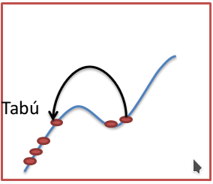
Búsqueda Tabú (Tabú Search)
Algorithm Tabu Search
1: l ← Desired maximun tabu list length
2: n ← number of tweaks desired to sample the gradient
3: S ← some initial candidate solution
4: Best ← S
5: L ← {} a tabu list of maximun length l
6: Enqueue S into L
7: repeat
8: if Length(L) > l then
9: Remove oldest element from L
10: R ← Tweak( Copy(S) )
11: for n ← 1 times do
12: W ← Tweak( Copy(S) )
13: if W ∉ L and (Quality(W)) > Quality(R) or R ∈ L then
14: R ← W
15: if R ∉ L and Quality(R) > Quality(S) then
16: S ← R
17: Enqueue R into L
18: if Quality(S) > Quality(Best) then
19: Best ← S
20: until Best is the ideal solution or we have run out of time
21: return Best

Slide 4
Búsqueda Tabú (Tabú Search) – Características modificadas
Algorithm Feature-based Tabu Search
1: l ← Desired queue length
2: n ← number of tweaks desired to sample the gradient
3: S ← some initial candidate solution
4: Best ← S
5: L ← {} a tabu list of maximun length l » L will hold tuples of the form <X,d> where X is a feature and d is a timestamp
6: c ← 0
7: repeat
8: c ← c +1
9: Remove from L all tuples of the form <X,d> where c – d < l
10: R ← Tweak( Copy(S), L) » Tweak wll not shift to a feature in L
11: for n ← 1 times do
12: W ← Tweak( Copy(S), L)
13: if (Quality(W)) > Quality(R) then
14: R ← W
15: S ← R
16: for each feature X modified by Tweak to produce R from S do
17: L ← L ∪ {<X,c>}
18: if Quality(S) > Quality(Best) then
19: Best ← S
20: until Best is the ideal solution or we have run out of time
21: return Best

Slide 5
Análisis de resultados

Slide 6
Conclusiones

Slide 7


